Slide 1
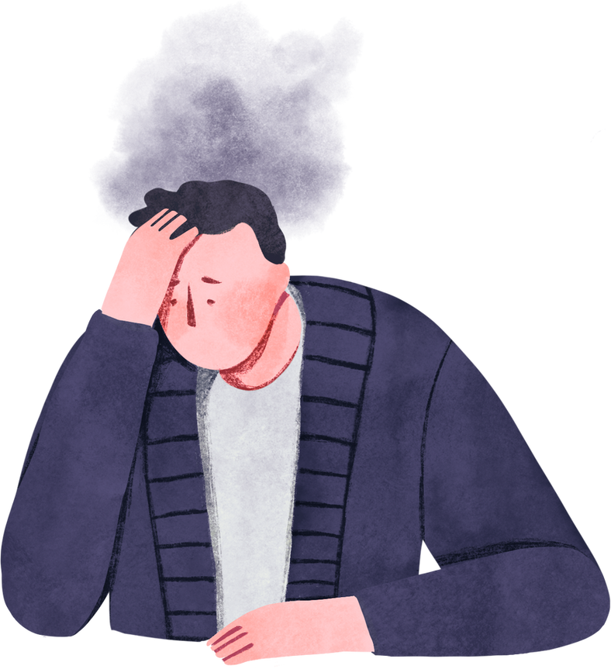
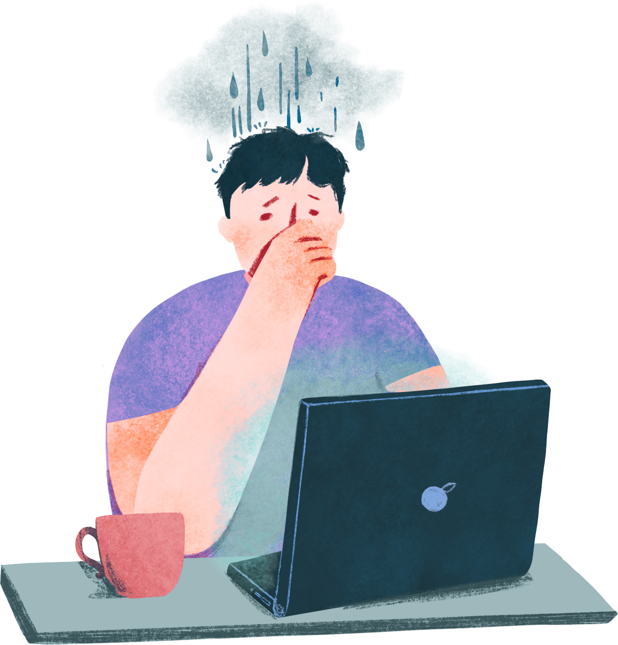
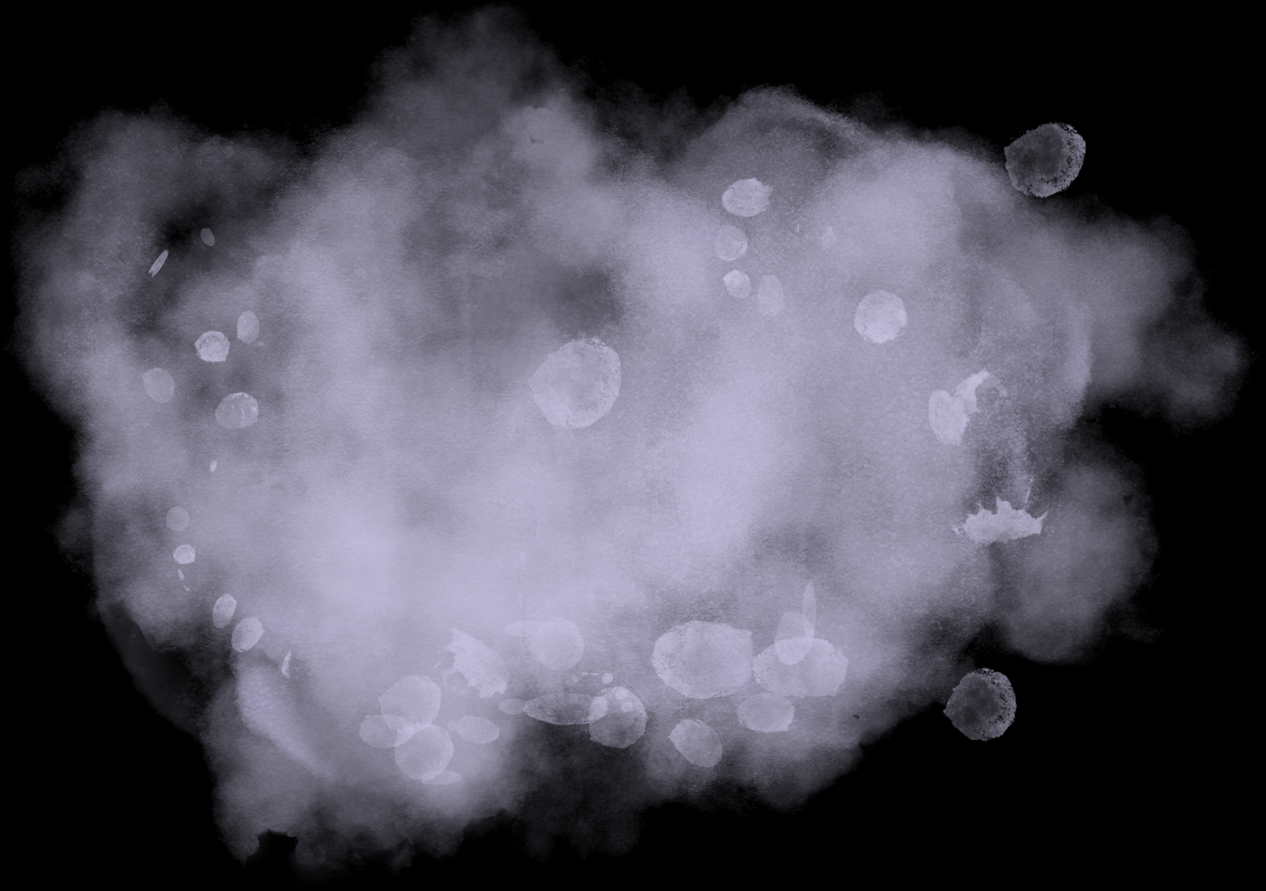



Social Media
Mental
Health.
NTI
Youssef Ibraim
Ziad adel
Ziad ashraf

Slide 2
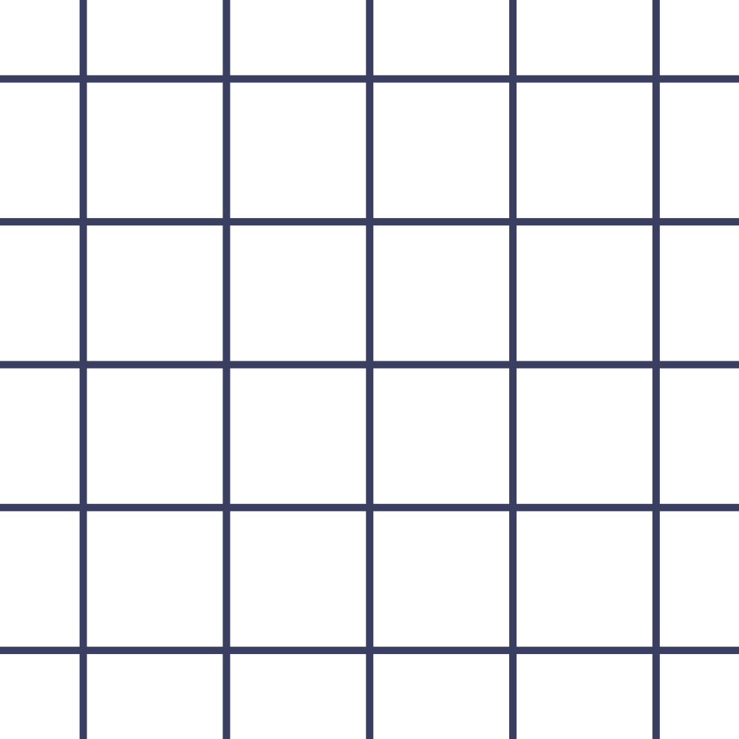


SOCIAL MEDIA
Python Project.PY
Presented by
Youssef Ibrahim

Slide 3
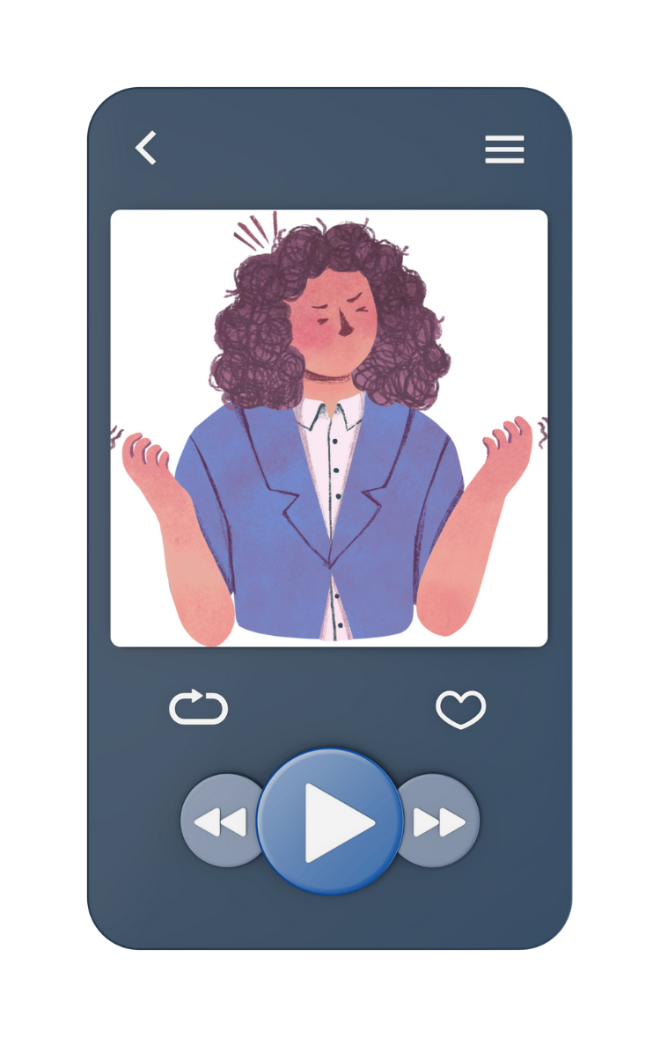

Mental Health & Social Media Dataset
The dataset focuses on understanding the relationship between social media usage, lifestyle factors, and mental health conditions. The main objective is to analyze how different factors affect an individual’s mental state and to prepare the data for Machine Learning tasks. The dataset contains multiple records representing individuals and their daily habits related to social media usage, sleep, physical activity, and psychological indicators such as stress, anxiety, .and mood

Slide 4

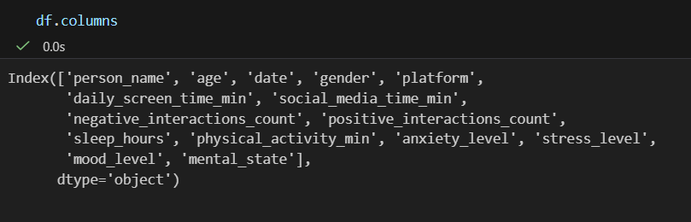
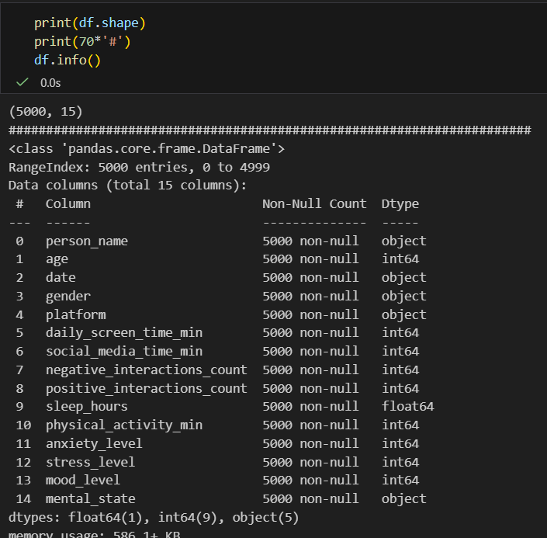
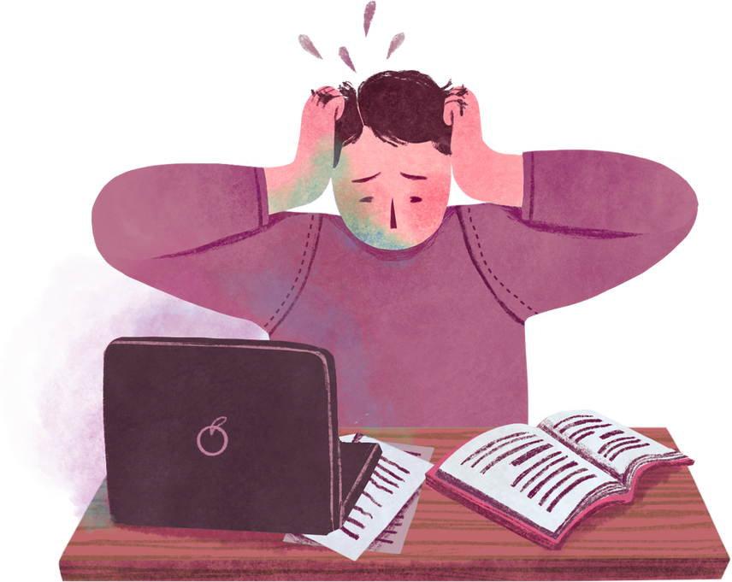
Data Import and Overview

Slide 5
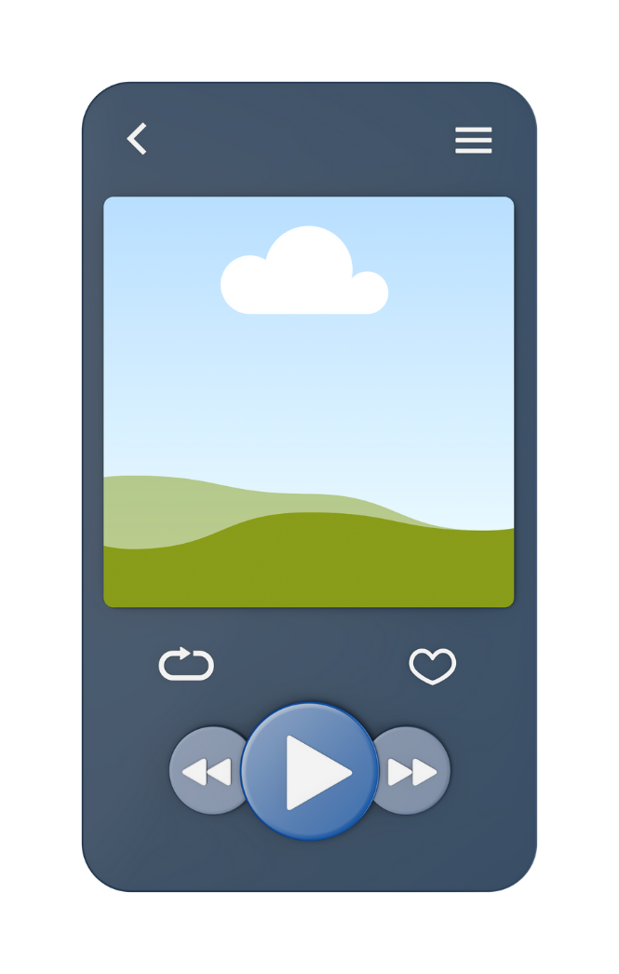
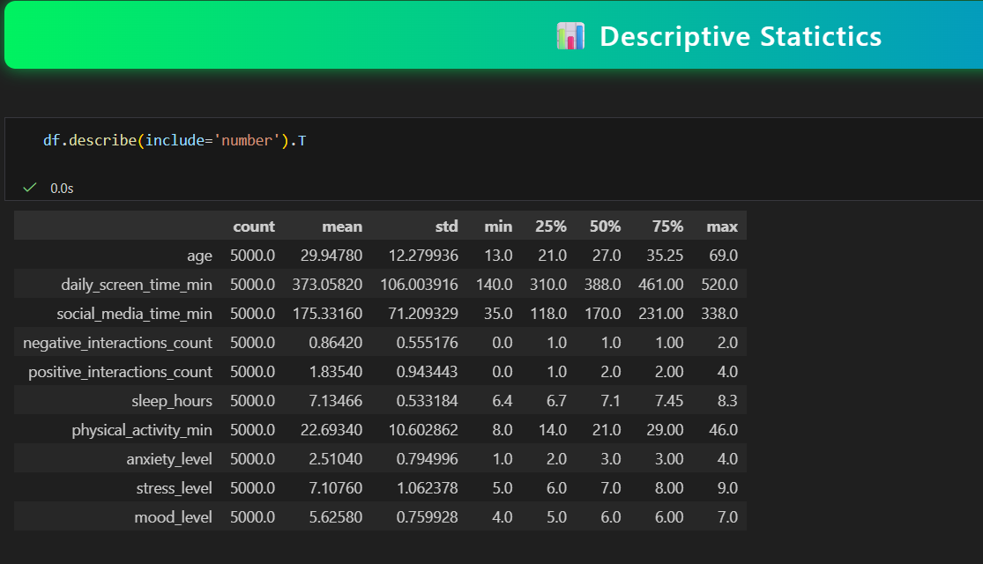
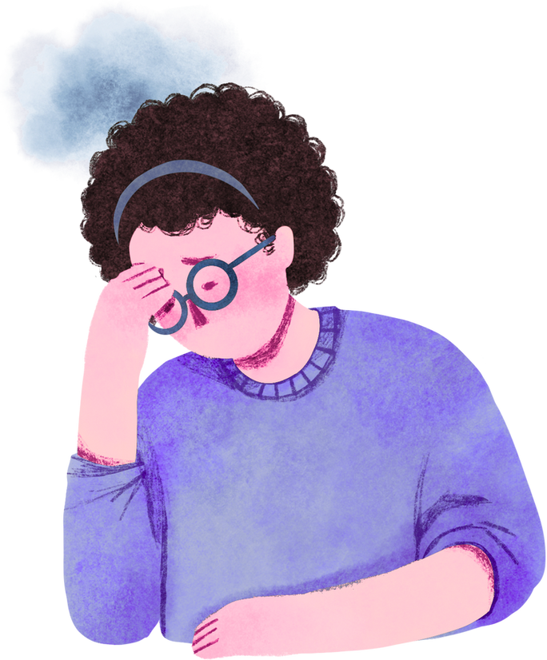
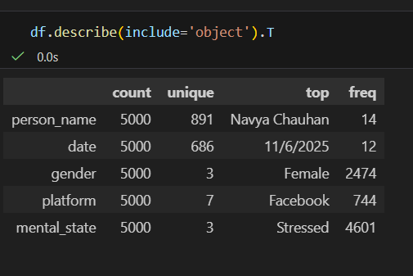

Slide 6
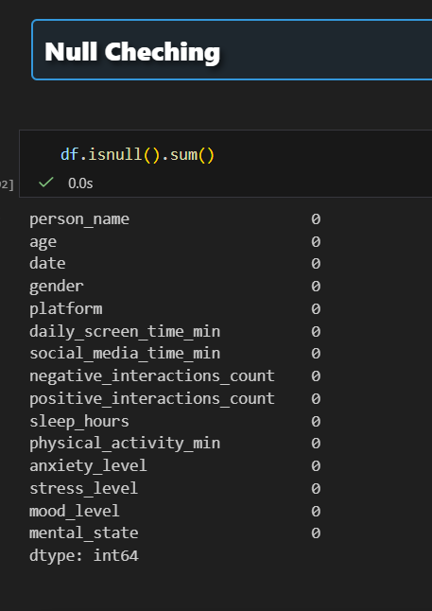
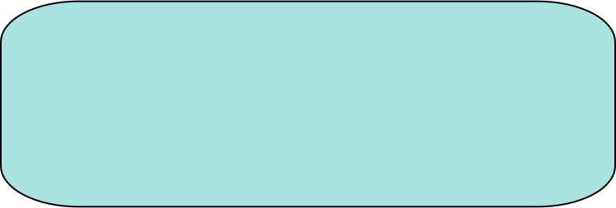
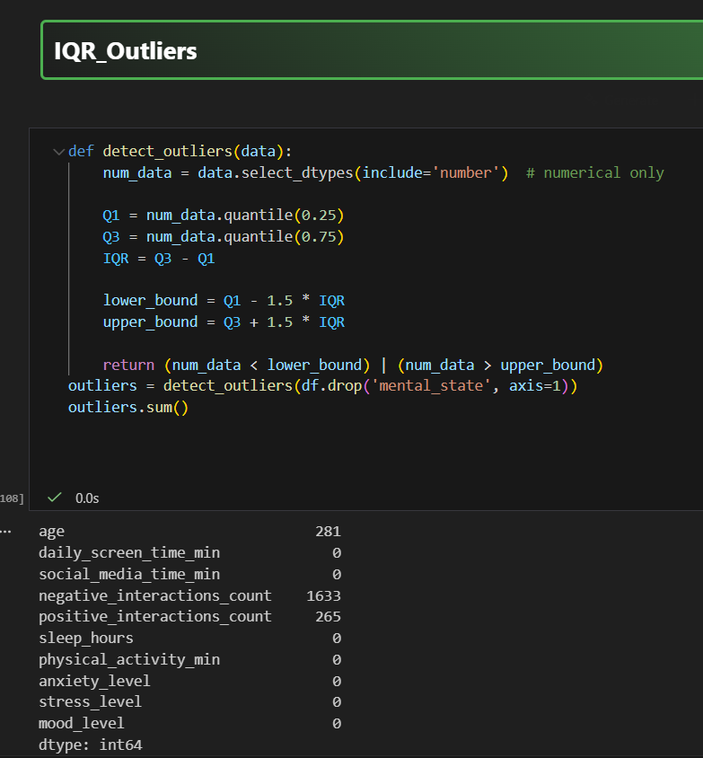
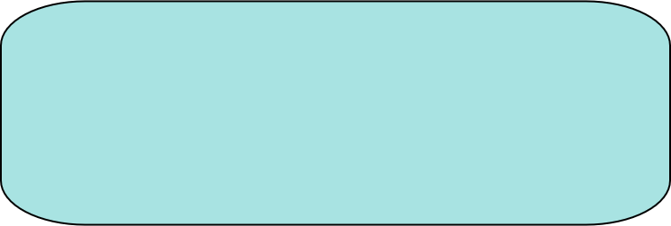
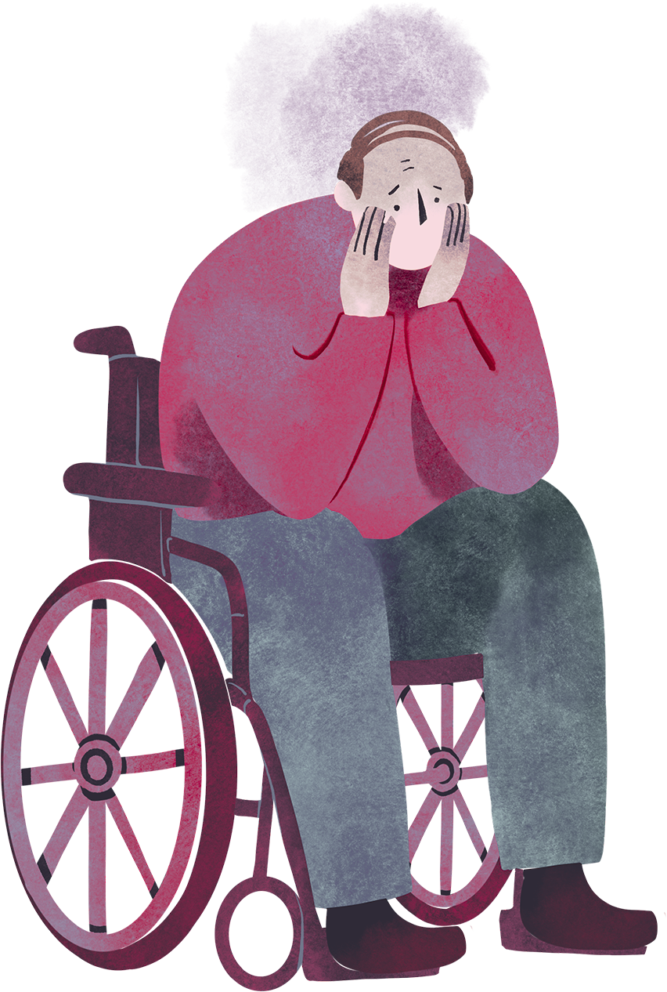
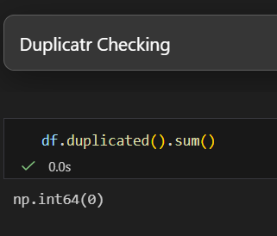
DataCleaning
There isn’t any Missing Value in Data
There isn’t any Duplicats in Data

Slide 7
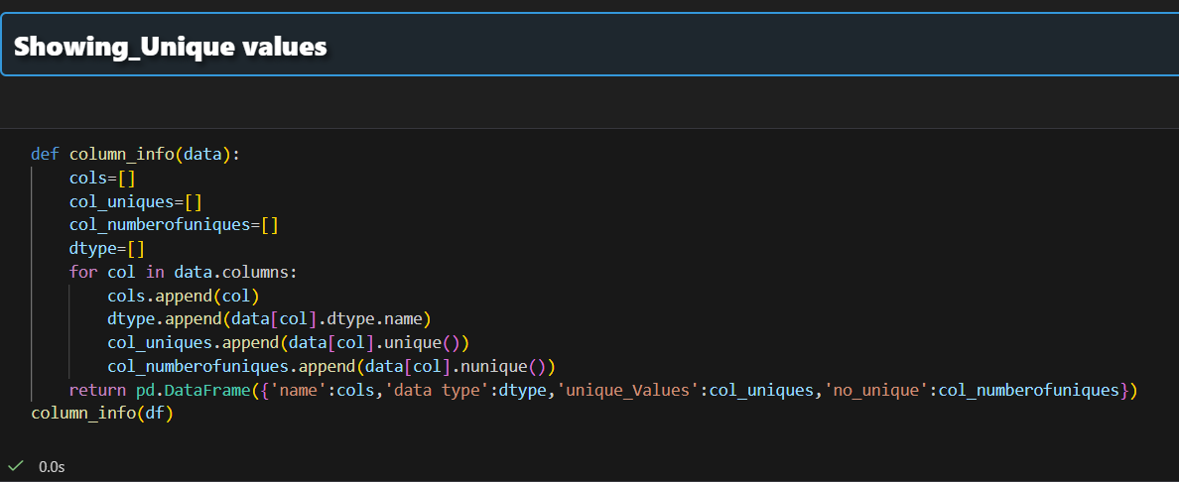
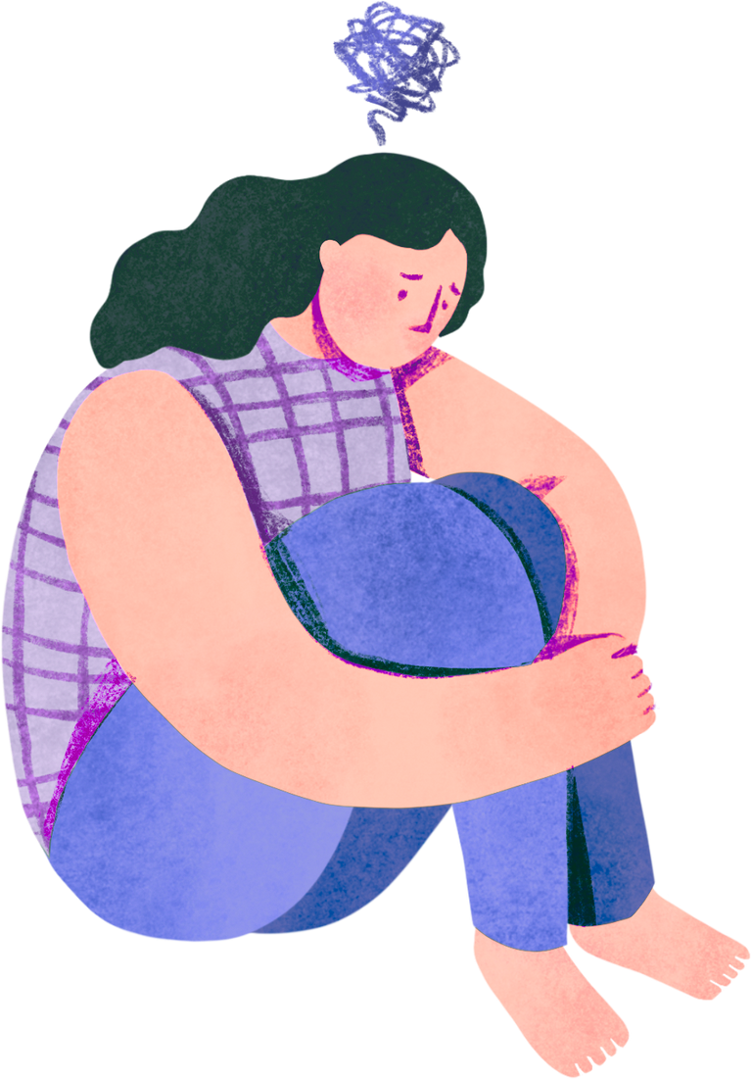
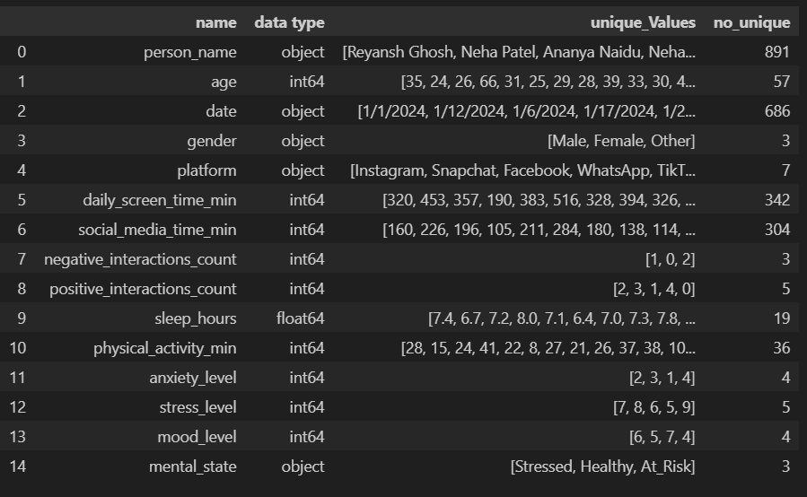

Slide 8

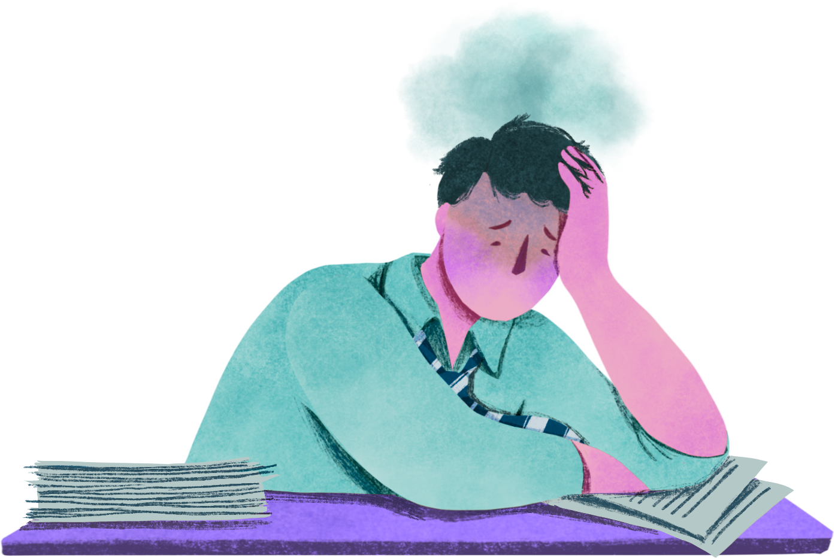


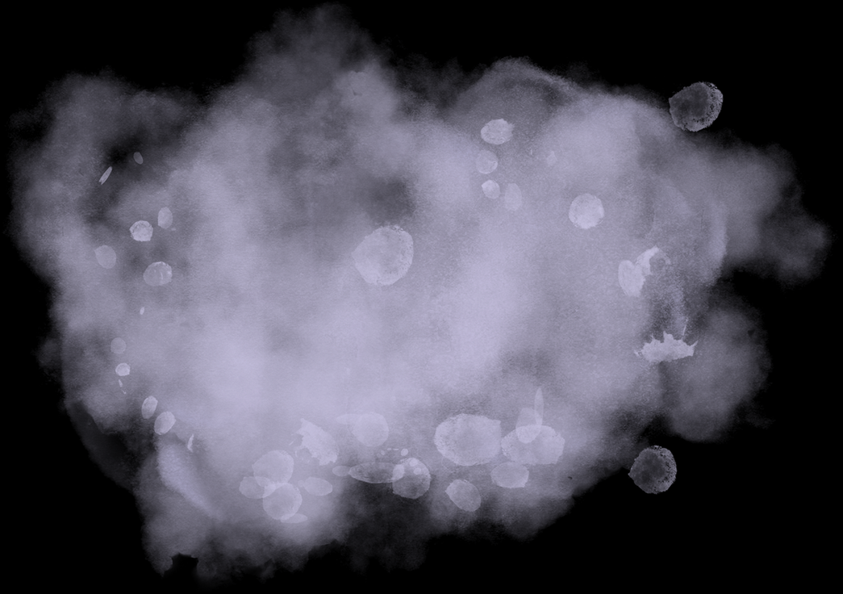
Data Vizualization
EDA
Preprocessing
Histogram
Encoding
Handling Unbalacing
Countplot
Boxplot For Outliers
Data Scaling
Handling Data
Heatmap for correlation

Slide 9
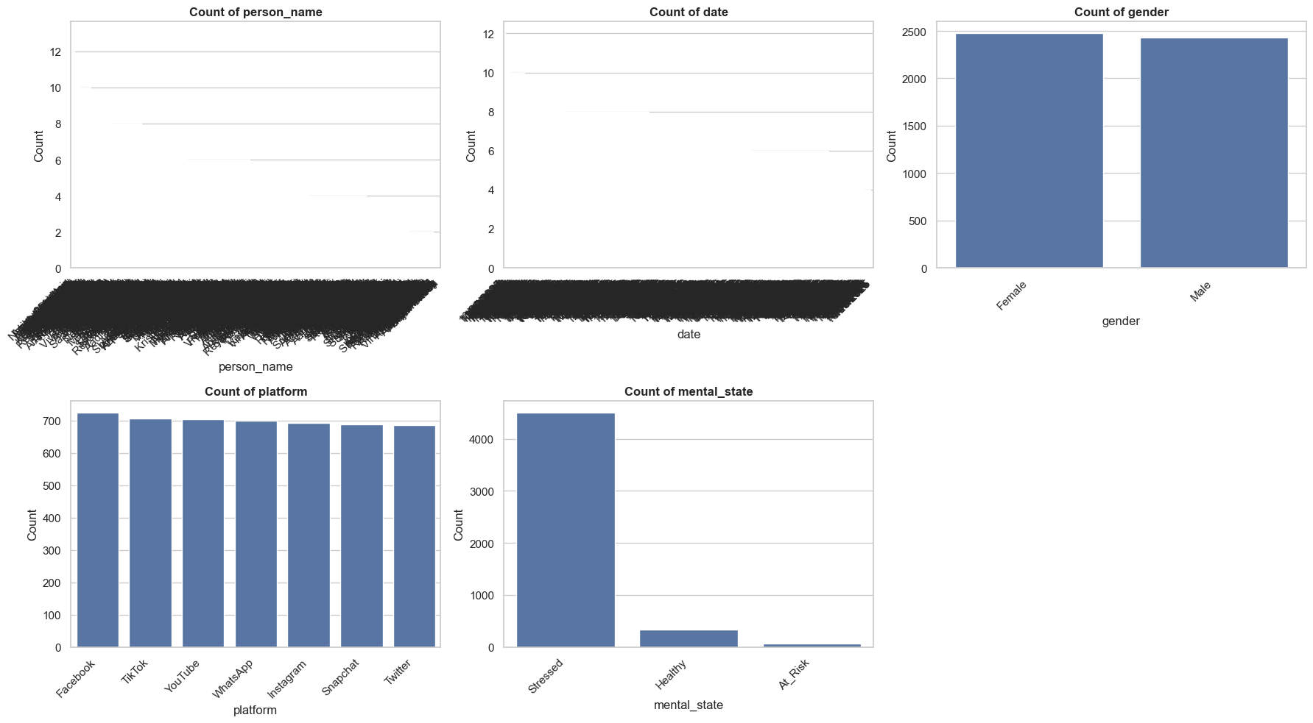
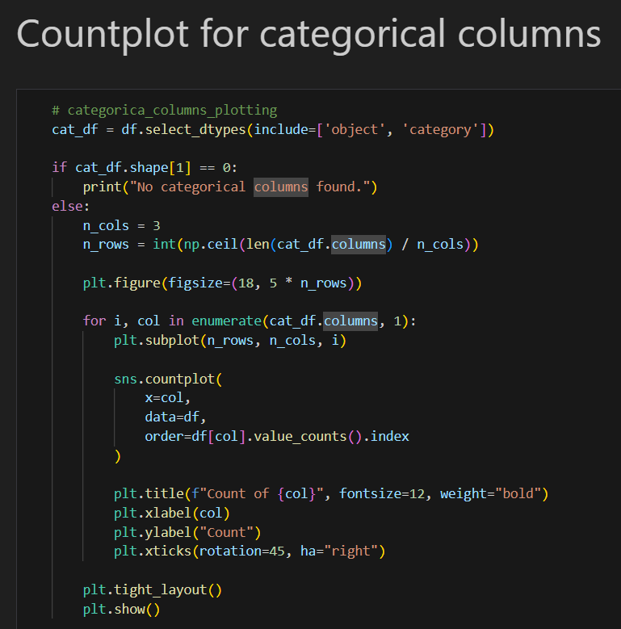


Slide 10
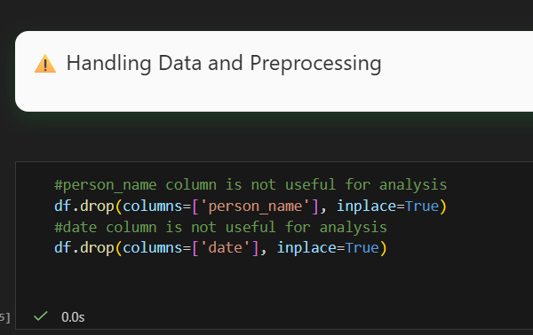
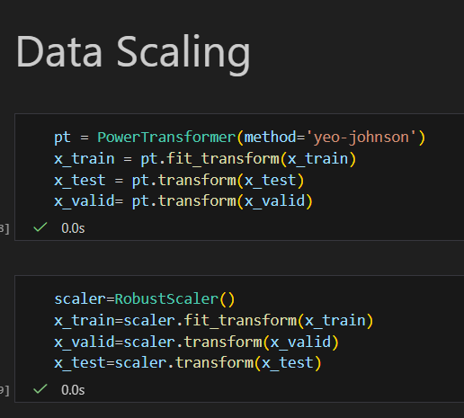



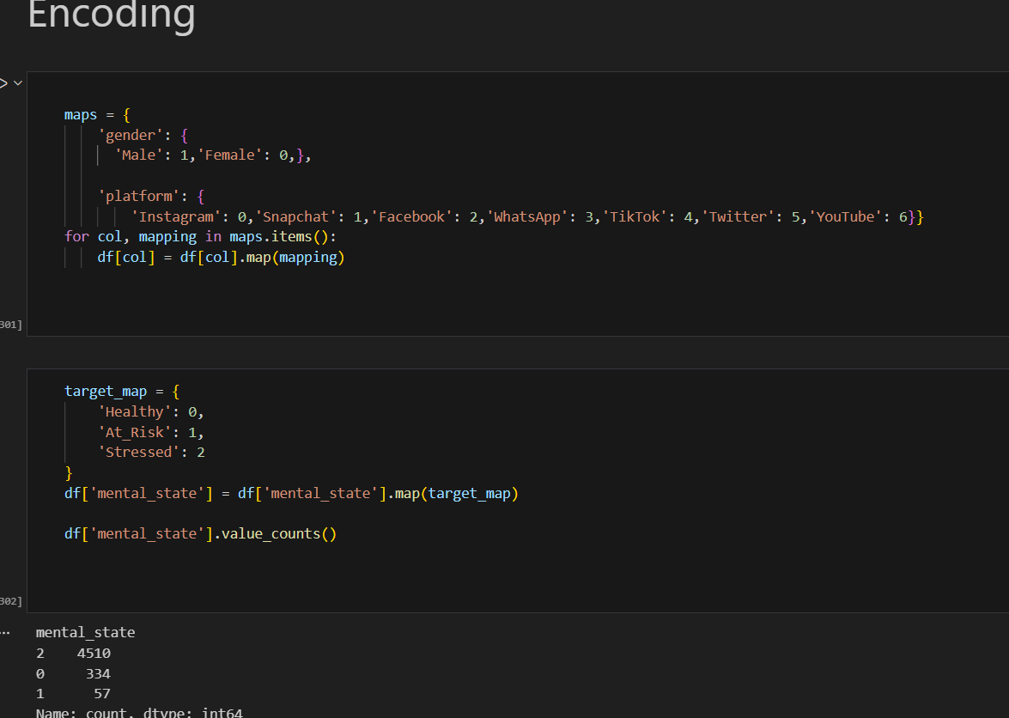
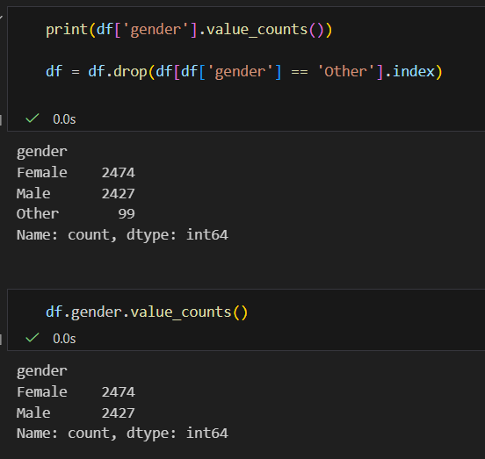

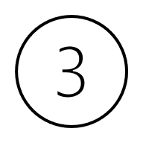
Removing Unuseful column
Remove rows their gender is HAHA
Encoding
categorical Columns

Slide 11
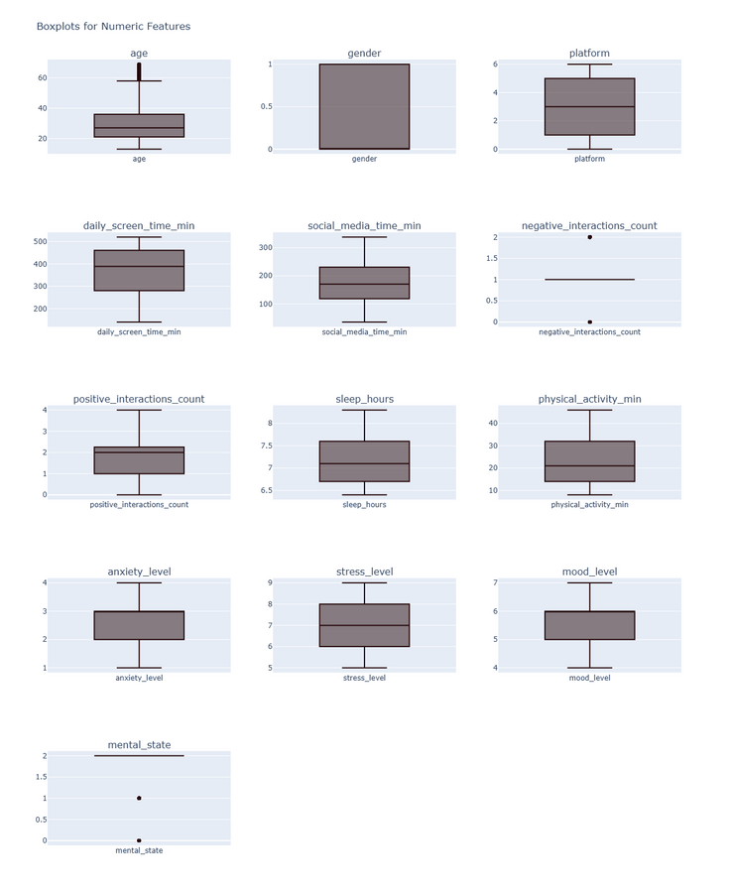
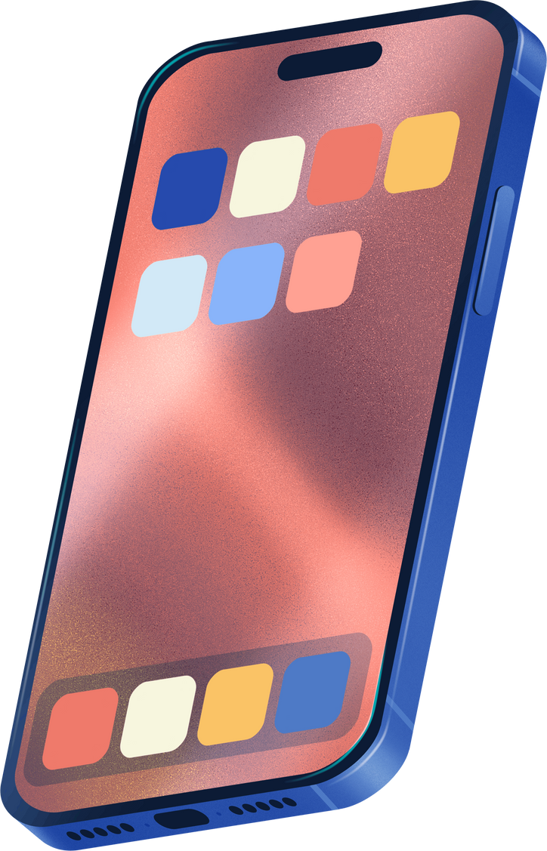
Boxplots to check the outliers
Insight
Most of the detected outliers represent realistic and meaningful behavior in the dataset rather than data entry errors. Therefore, outliers were not removed. Instead, their impact was reduced using appropriate techniques (such as capping, transformation, or robust scaling) when necessary, in order to preserve data integrity and avoid information loss.

Slide 12
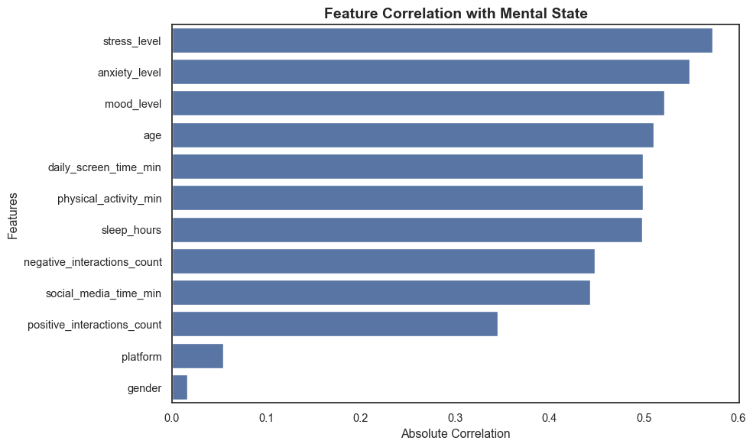

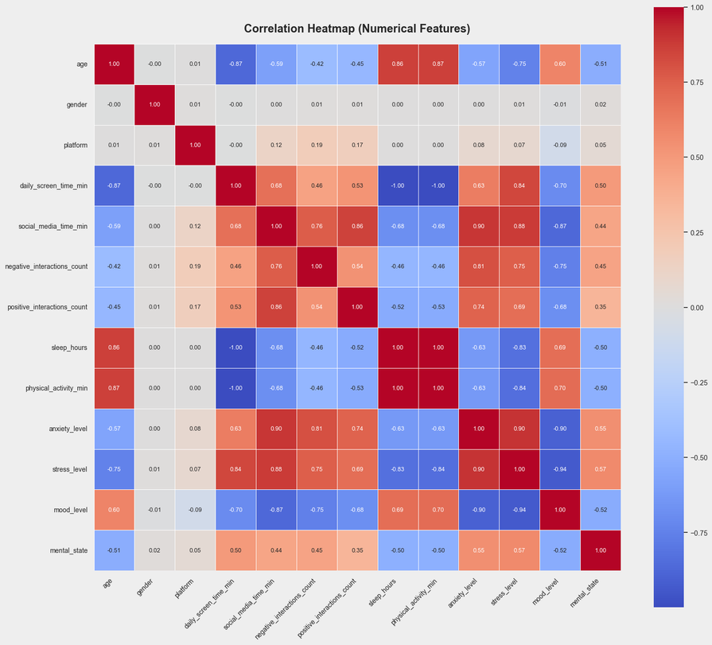
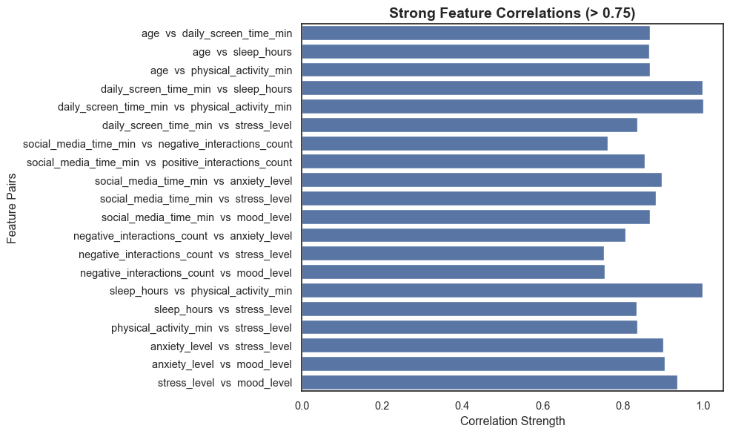
Heatmap for correlation

Slide 13

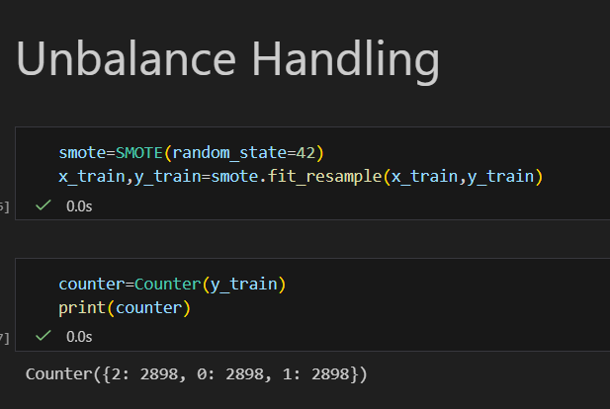
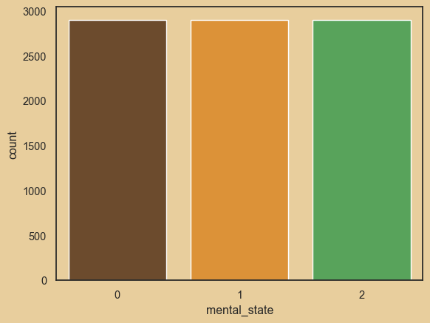
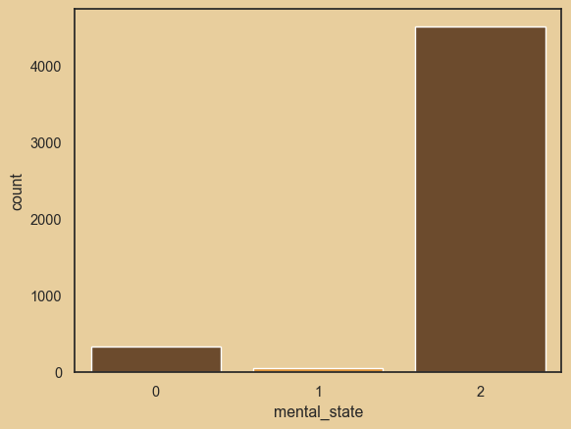


UnBalance Handling
Because Your Mind Matters!

Slide 14
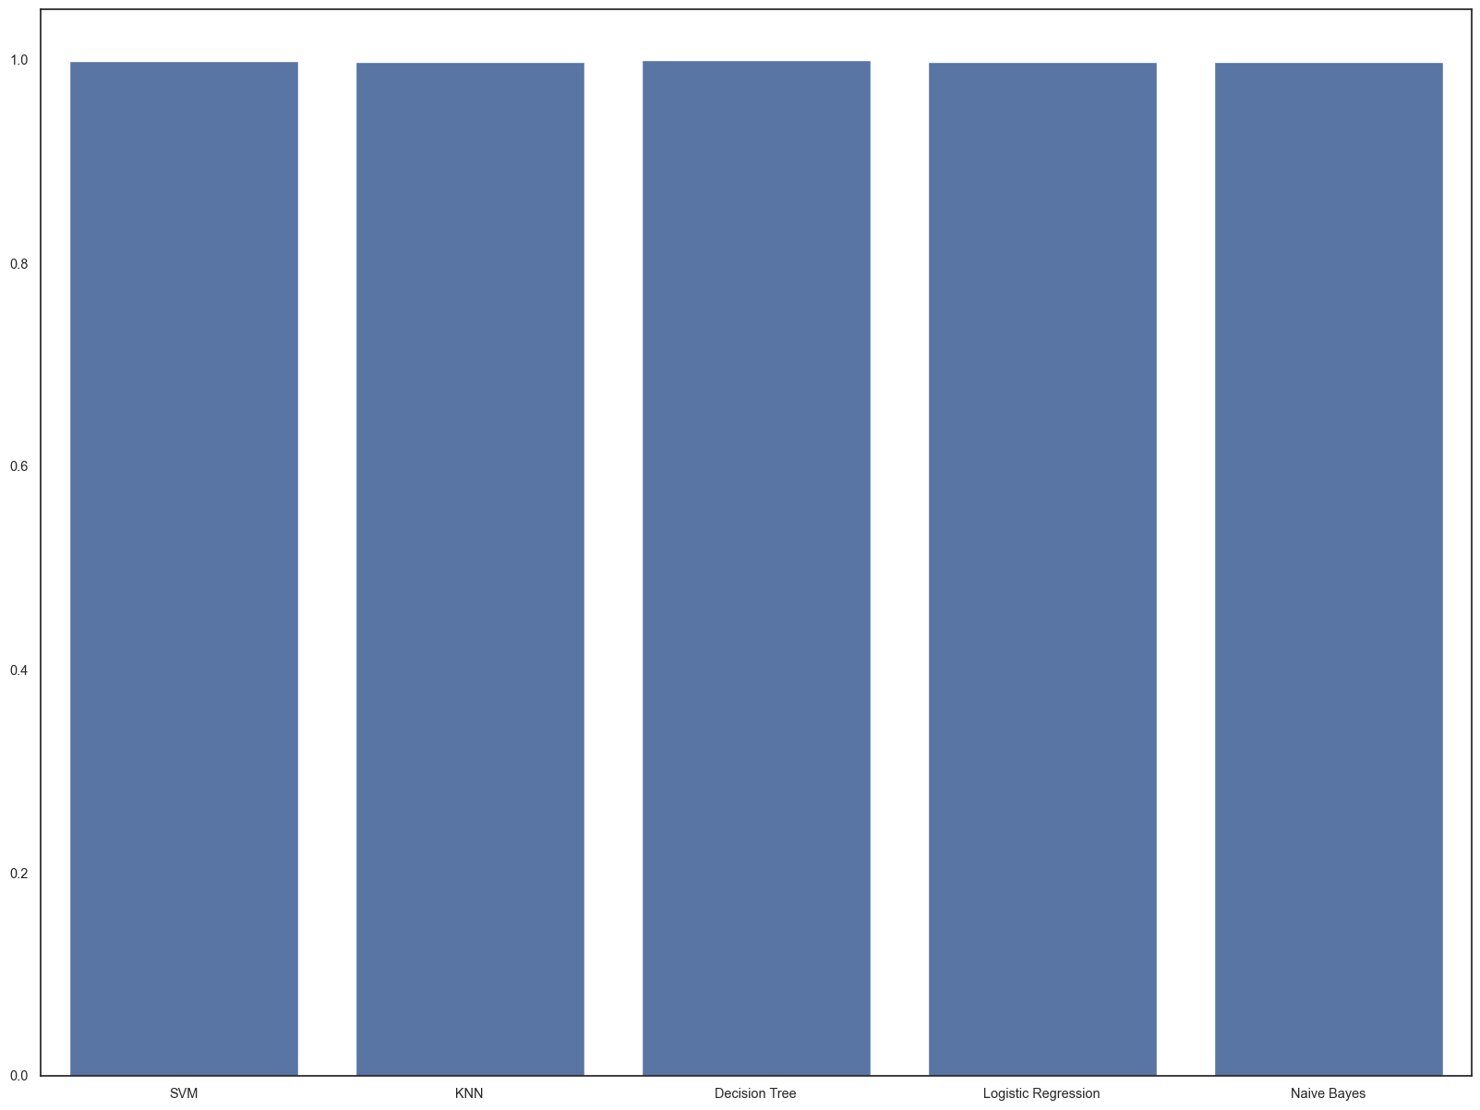
Machine Learning Models
Naive Bayes
Logistic Regresion
Desion Tree
SVM
KNN

Slide 15

THANK YOU
I am happy to answer any questions
J0o0.

Slide 16


IMPACT OF SOCIAL MEDIA ON MENTAL HEALTH
A Data Analysis Project Using SQL

Slide 17

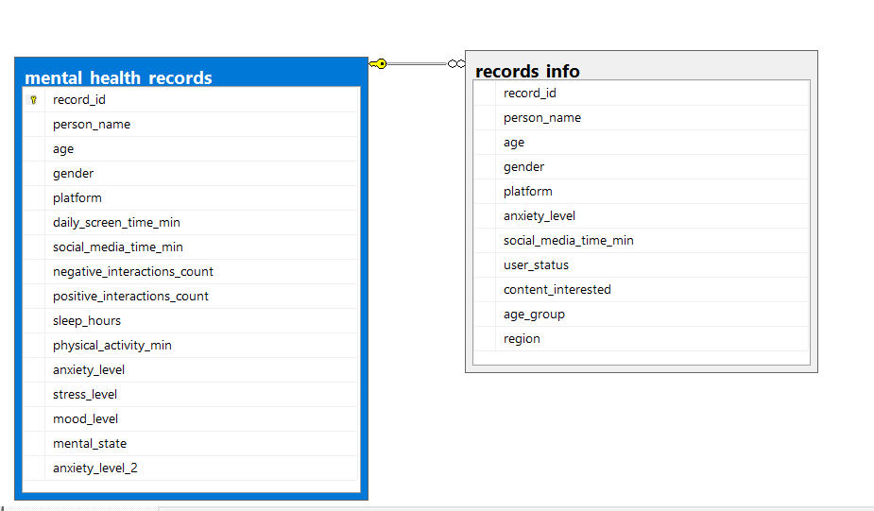

DATASET OVERVIEW
DATA STRUCTURE
The analysis is built upon two primary relational tables containing approximately 5,000 user records:
Mental Health Table: Contains quantitative metrics for Anxiety, Stress, Sleep Hours, and Mood scores.
Records_info Table: Stores RecordID, Age Group, Geographic Region, and primary Social Media Platform.

Slide 18

GENDER DISTRIBUTION
Female Users (51%)
Male Users (49%)
The dataset is perfectly balanced, ensuring that the insights derived regarding mental health are not skewed by gender-specific biases.

Slide 19
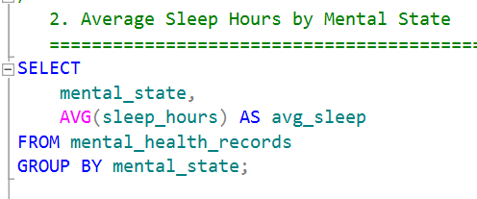
AVERAGE SLEEP BY MENTAL STATE

Slide 20
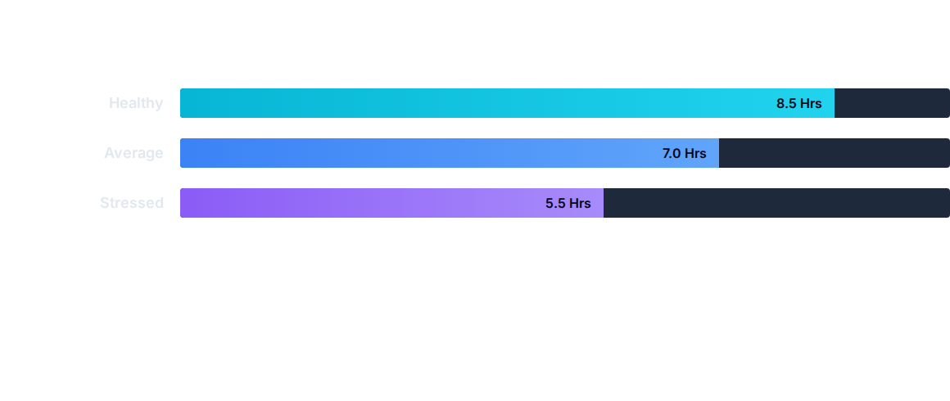
AVERAGE SLEEP BY MENTAL STATE
There is a clear negative correlation between stress and sleep. Users classified as "Stressed" average 3 hours less sleep than "Healthy" users.

Slide 21
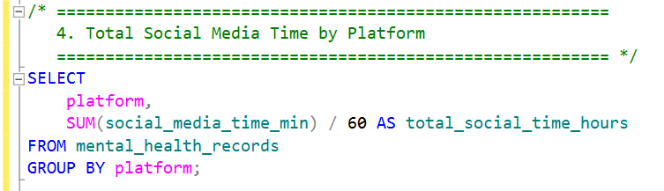
TOTAL USAGE TIME BY PLATFORM

Slide 22
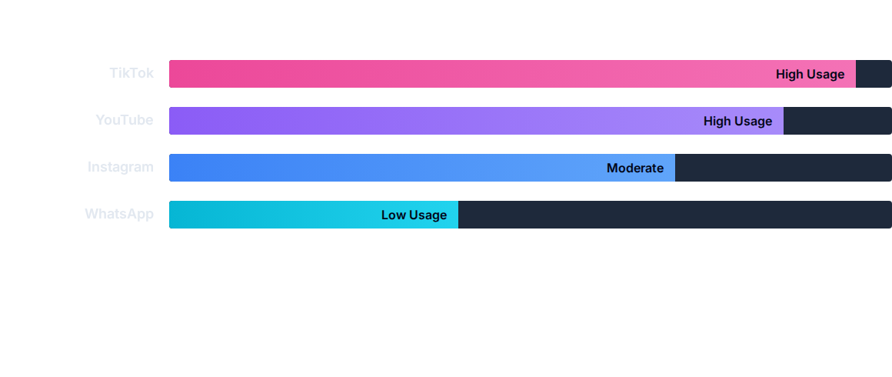
TOTAL USAGE TIME BY PLATFORM
2920 Hours
2648 Hours
2366 Hours
1131 Hours
Algorithm-driven platforms like TikTok and YouTube command significantly higher screen time compared to communication-focused apps.

Slide 23
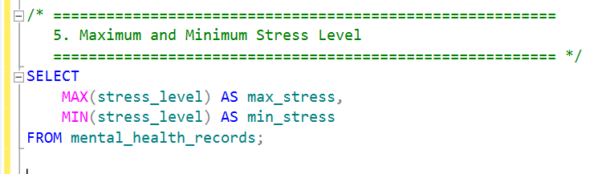
STRESS LEVEL RANGE

Slide 24


STRESS LEVEL RANGE
9
5
MAX STRESS SCORE
MIN STRESS SCORE
The baseline stress level in the dataset is 5, indicating that the majority of the user base is experiencing at least moderate levels of stress.

Slide 25

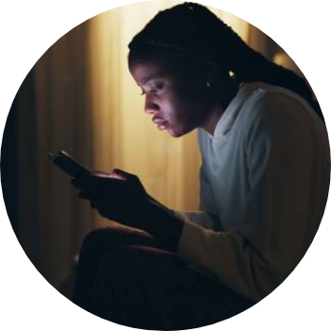
PREVALENCE OF STRESS
92%
CLASSIFIED AS "STRESSED"
An overwhelming majority of the analyzed user base falls into the stressed category, suggesting a systemic issue within the sampled social media population.

Slide 26




REGIONAL IMPACT: URBAN VS. RURAL
URBAN AREAS
RURAL AREAS
Significantly higher incidence of stress cases. Factors include fast-paced lifestyle, higher digital saturation, and work pressure.
Comparatively lower stress levels. While digital penetration is high, the correlation with extreme anxiety is less pronounced.

Slide 27
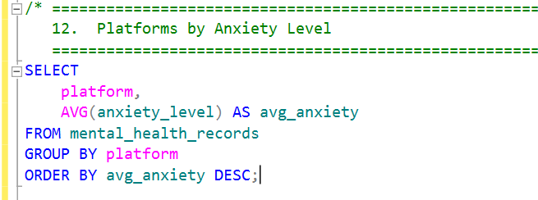
PLATFORM VS. ANXIETY LEVELS

Slide 28
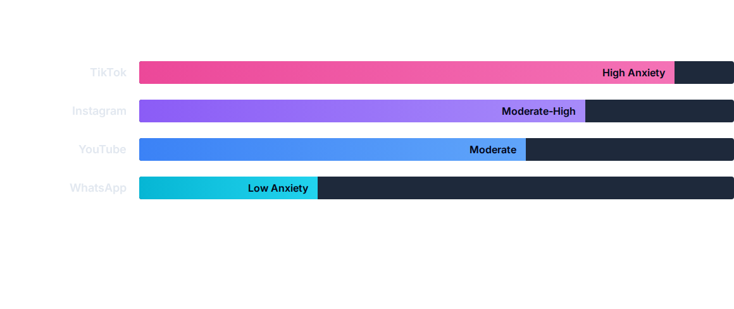
PLATFORM VS. ANXIETY LEVELS
Short-form content platforms correlate with higher anxiety, whereas direct communication tools show the lowest impact.

Slide 29
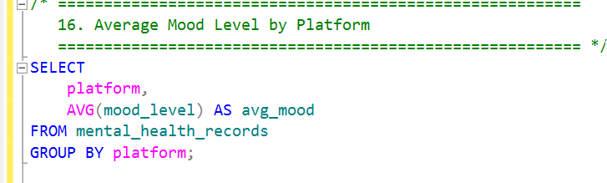
AVERAGE MOOD SCORE BY PLATFORM

Slide 30
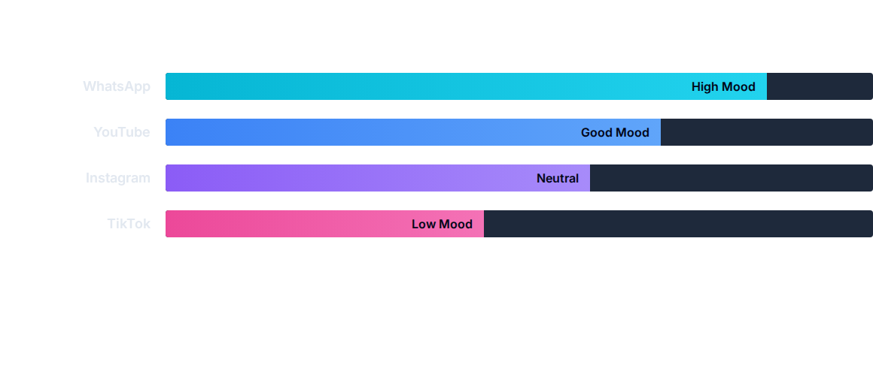
AVERAGE MOOD SCORE BY PLATFORM
Inverse to anxiety, mood scores are highest on communication apps and lowest on high-frequency scrolling apps.

Slide 31

ADVANCED SQL TECHNIQUES :
Create View

Slide 32

ADVANCED SQL TECHNIQUES :
Create Stored Procedure

Slide 33

ADVANCED SQL TECHNIQUES :
Create Function

Slide 34





CONCLUSION
PLATFORM MATTERS
SLEEP CORRELATION
DIGITAL WELLBEING
Not all screen time is equal. Short-form algorithmic content is more strongly linked to anxiety than communication apps.
There is an undeniable link between high stress levels and reduced sleep duration among users.
Awareness of these patterns is critical for developing healthier digital habits and improving mental hygiene.

Slide 35
THANK YOU
I am happy to answer any questions.
Prepared By: Ziad Adel

Slide 36
Recommendations for Improving Mental Health on Social Media
Limit Screen TimeSet daily time limits for social media use to reduce overexposure and prevent mental fatigue, anxiety, and sleep disruption.
Promote Positive and Educational ContentFollow accounts that encourage motivation, learning, and well-being, and unfollow or mute sources that trigger stress or negative emotions.
Encourage Digital Detox PeriodsTaking regular breaks from social media helps restore focus, reduce comparison, and improve emotional balance.
Increase Awareness of Unrealistic StandardsEducate users about edited images and curated lifestyles to reduce unhealthy comparisons and protect self-esteem.
Use Social Media for Connection, Not ValidationFocus on meaningful interactions and communication rather than likes, shares, and follower counts.

Slide 37
DASHBOARDS
Prepared by :Ziad Ashraf
There isn’t any Duplicats in Data
1-Excel
2-PowerBI
3-Tablue

Slide 38




THANK YOU
Ziad Adel
Youssef ibrahim
Ziad Ashraf

